Slide 1
Farmshop: Connecting Farms to your home Digital media project
Sarina Jimi
NP01MM4S220014

Slide 2
Introduction
The title of my project is “Farmshop: Connecting Farms to Your Home.” This title was chosen because the video aims to highlight how fresh and organic the produce from Farmshop really is. Through a captivating blend of 2D animation, motion graphics, and text narration, the video promotes both the brand and its app, which allows customers to easily order farm-fresh produce.

Slide 3
Pre-Production

Slide 4
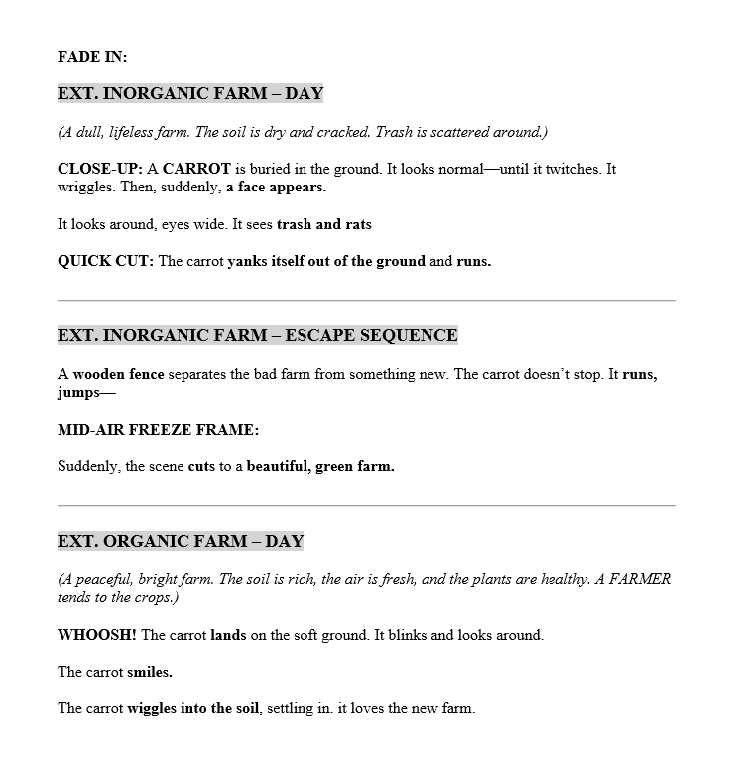
Project Development Process

Slide 5
Production

Slide 6
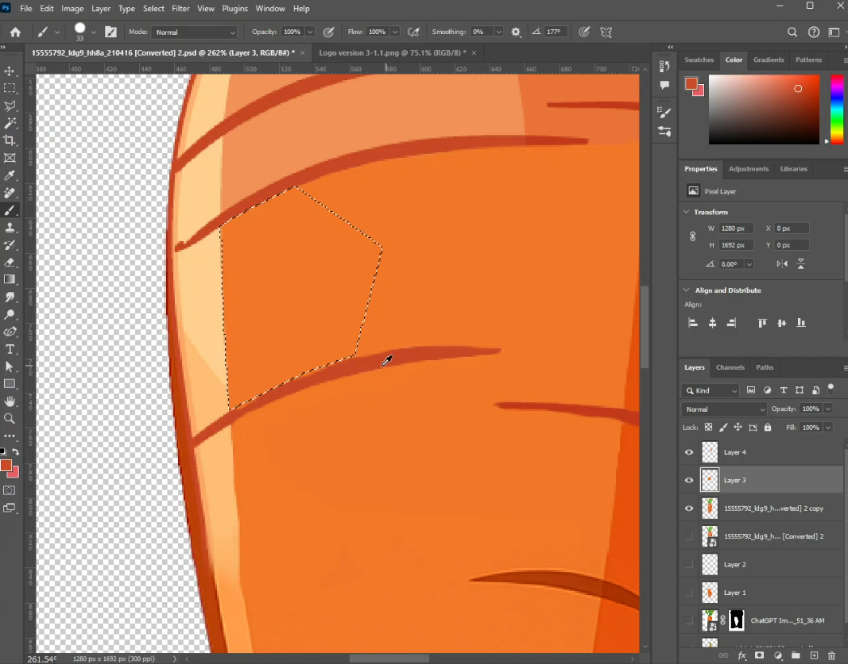
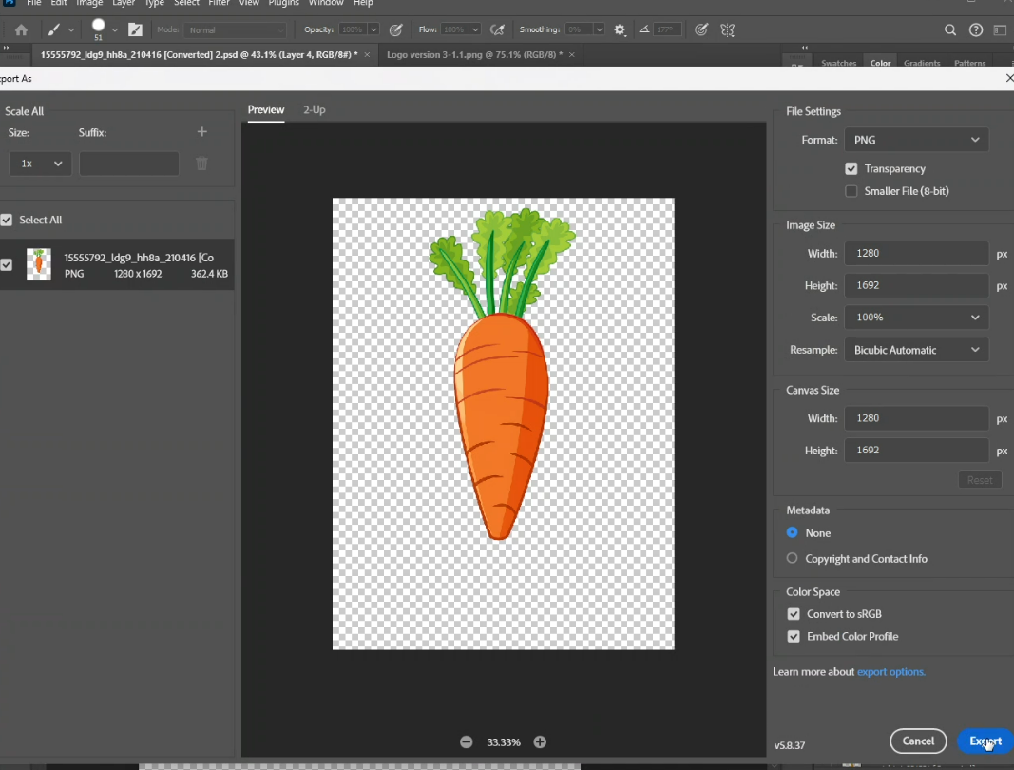
Project Development Process

Slide 7
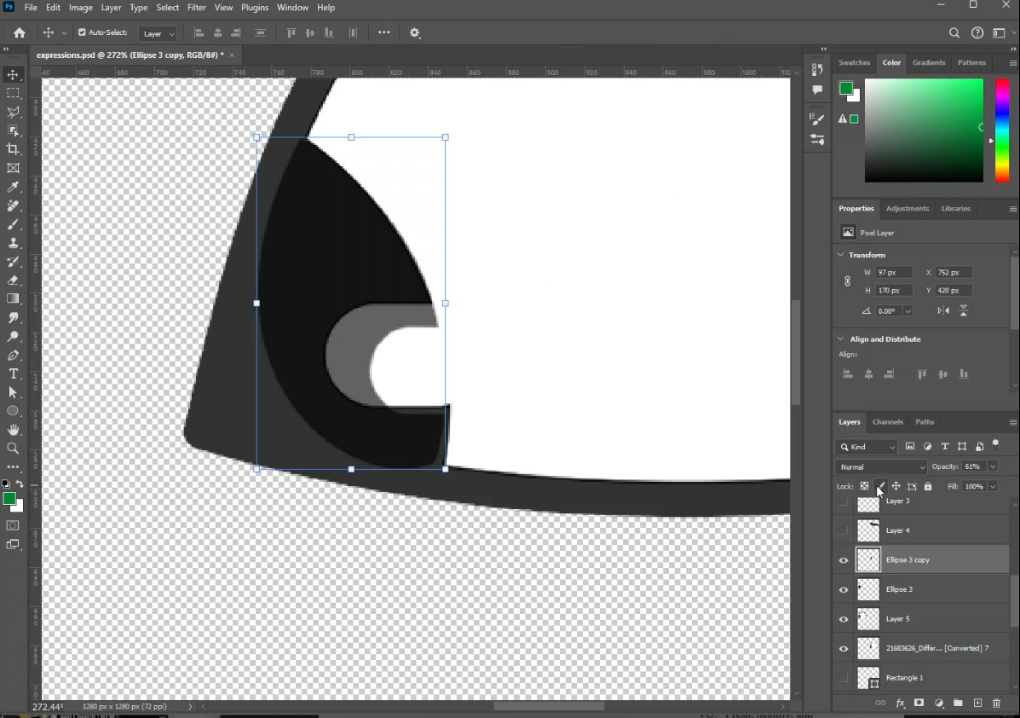
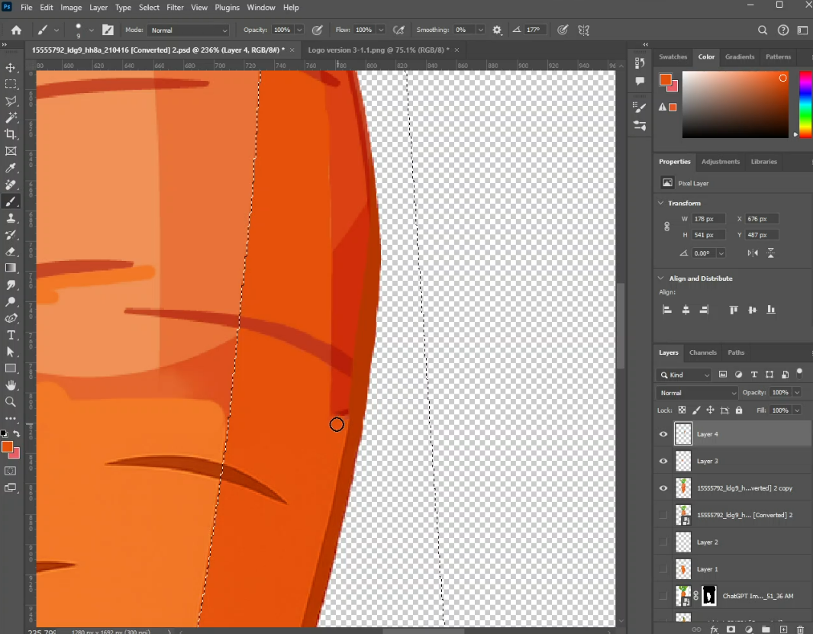
Project Development Process

Slide 8
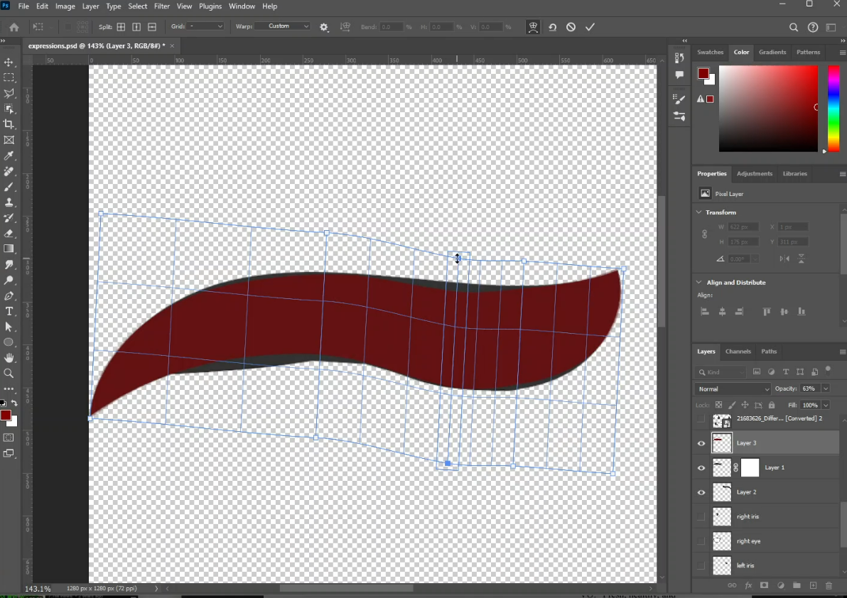
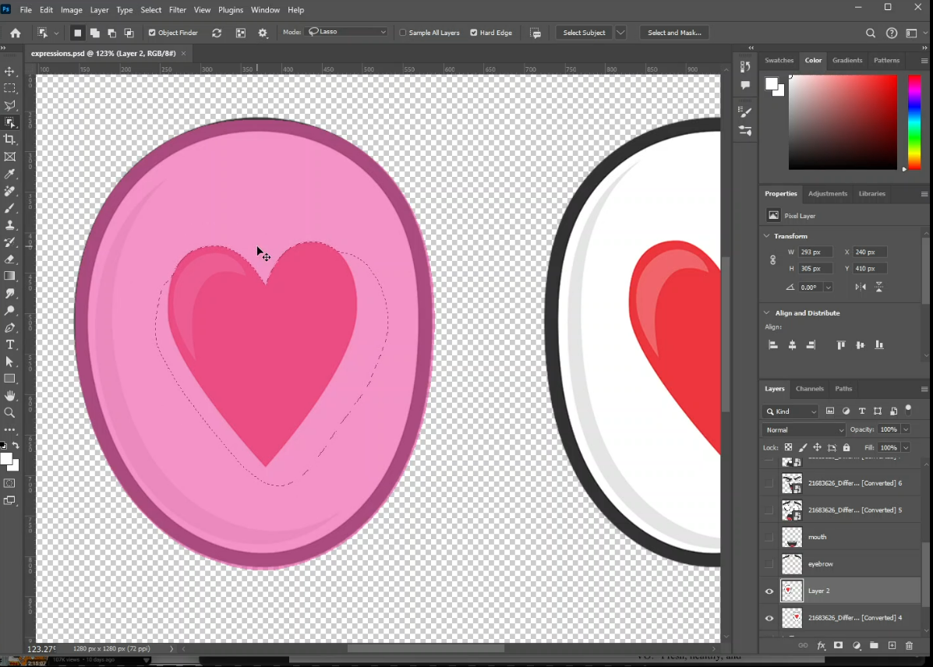
Project Development Process

Slide 9
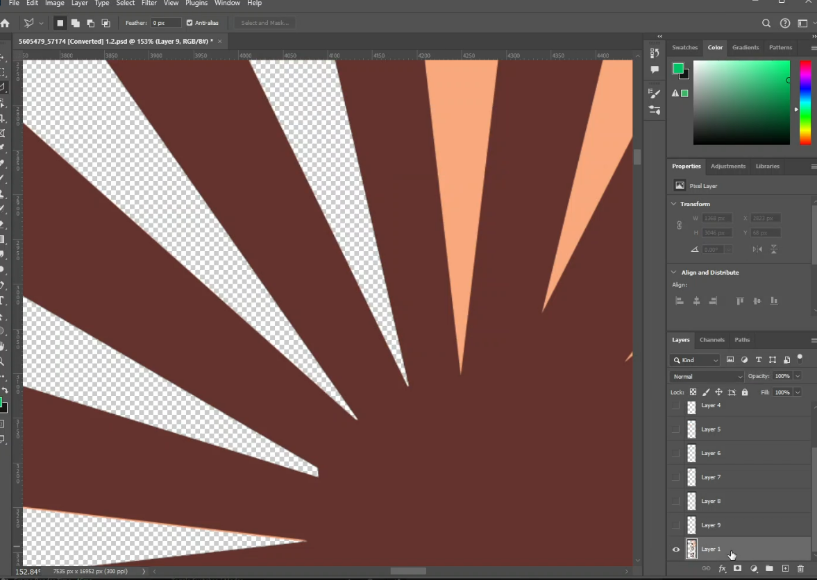
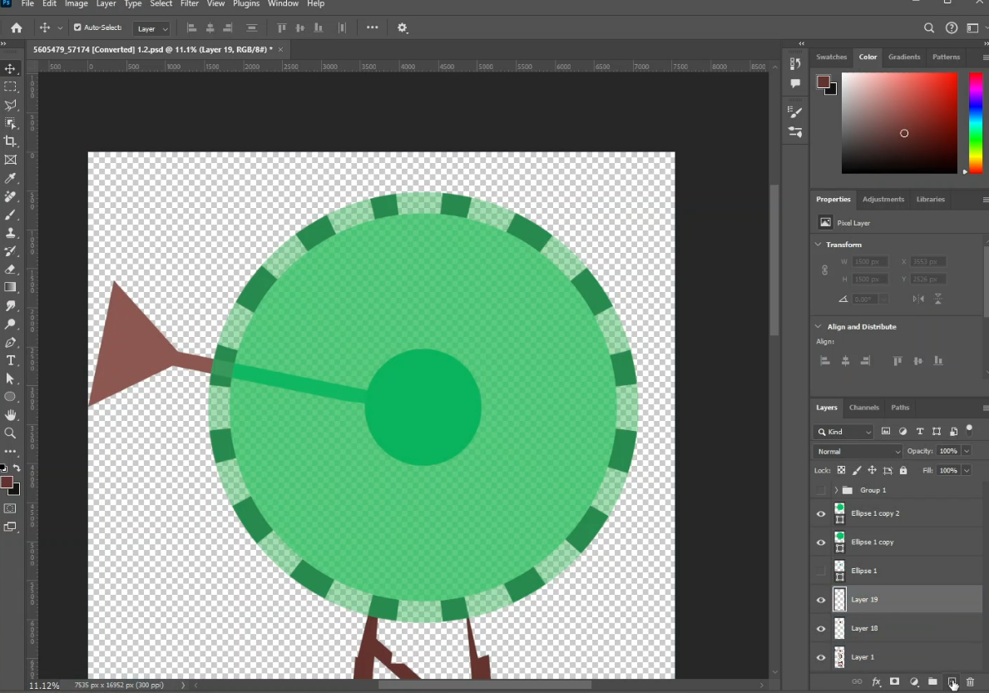
Project Development Process

Slide 10
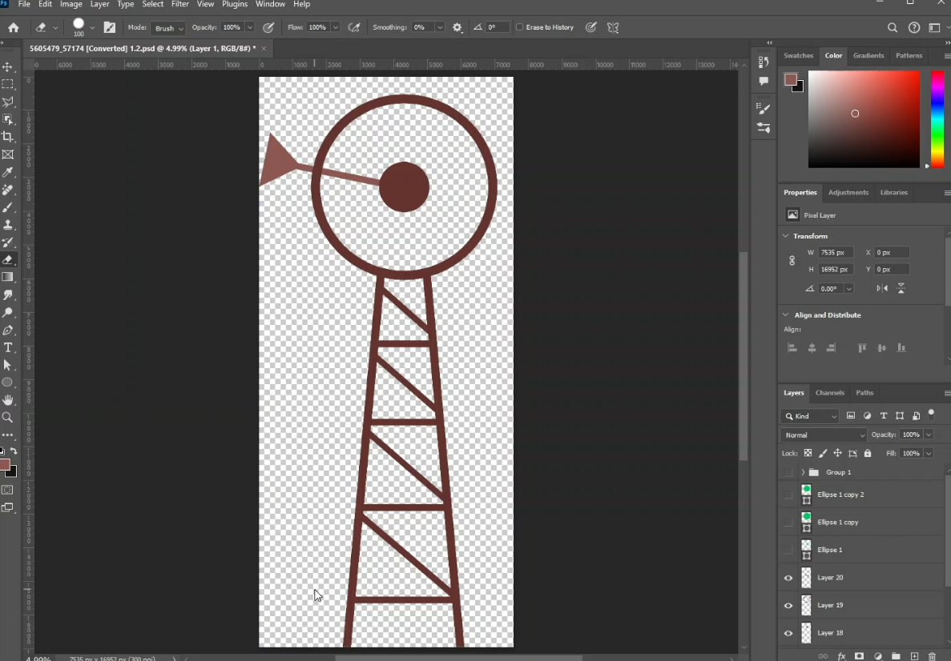
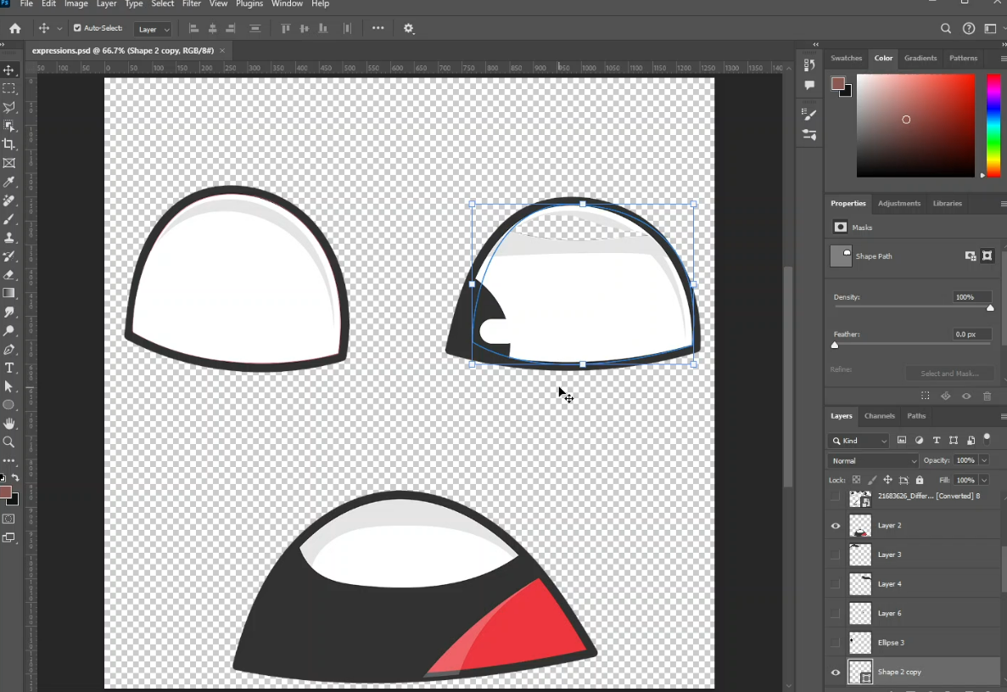
Project Development Process

Slide 11
Post-Production

Slide 12
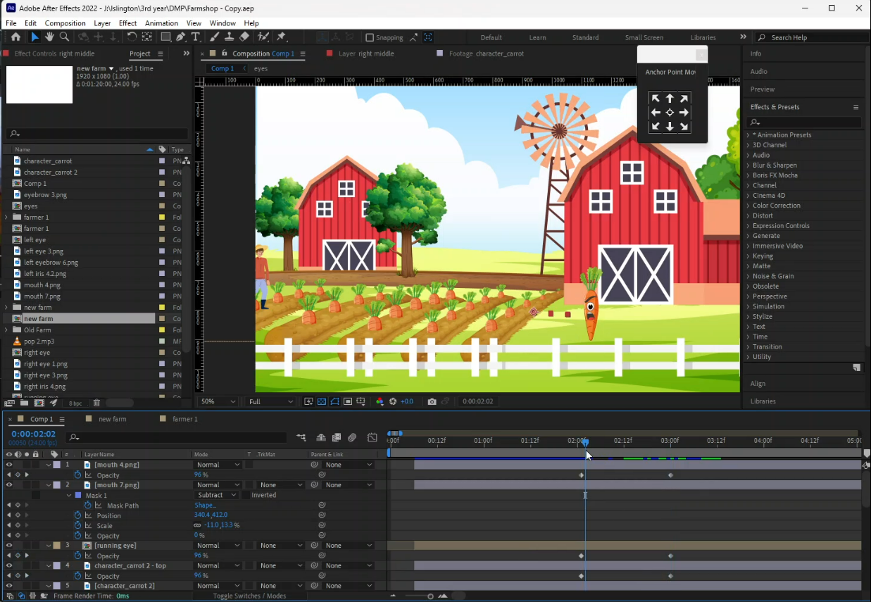
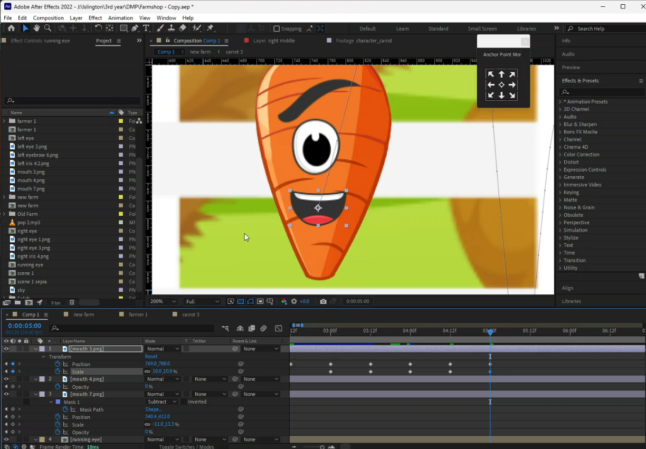
Project Development Process

Slide 13
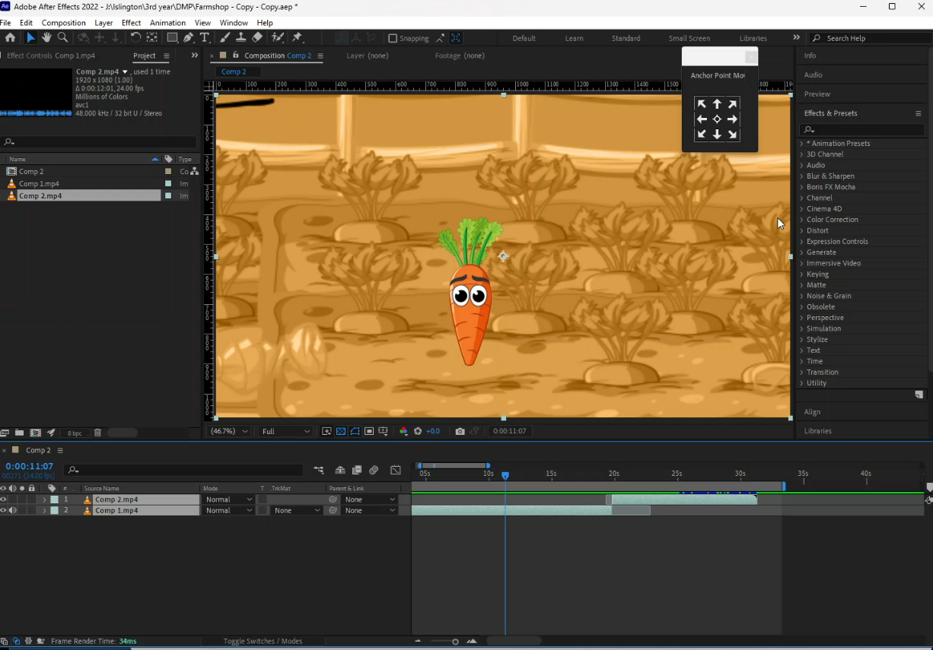
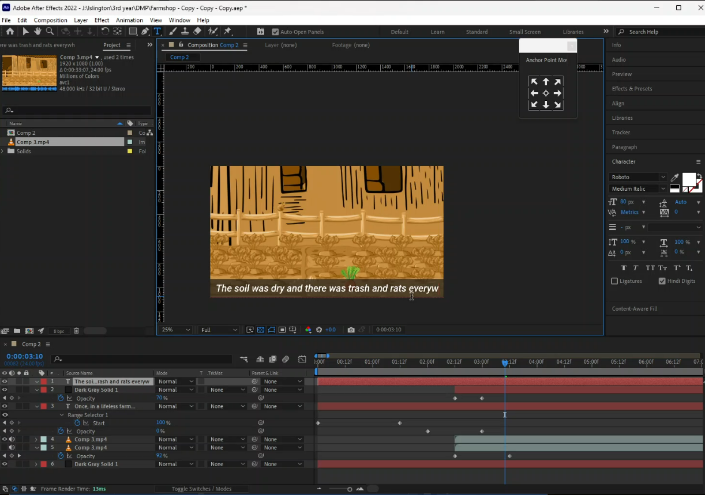
Project Development Process

Slide 14
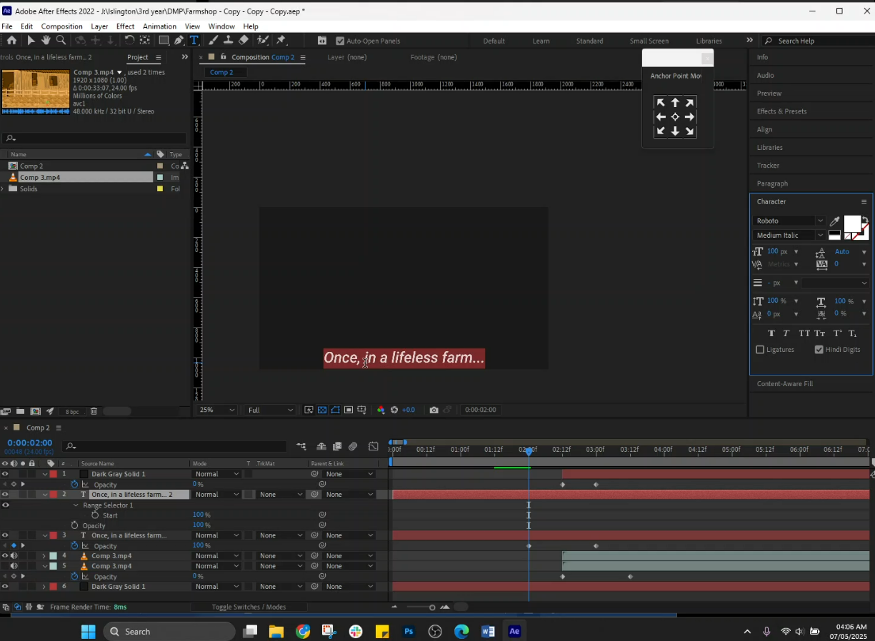
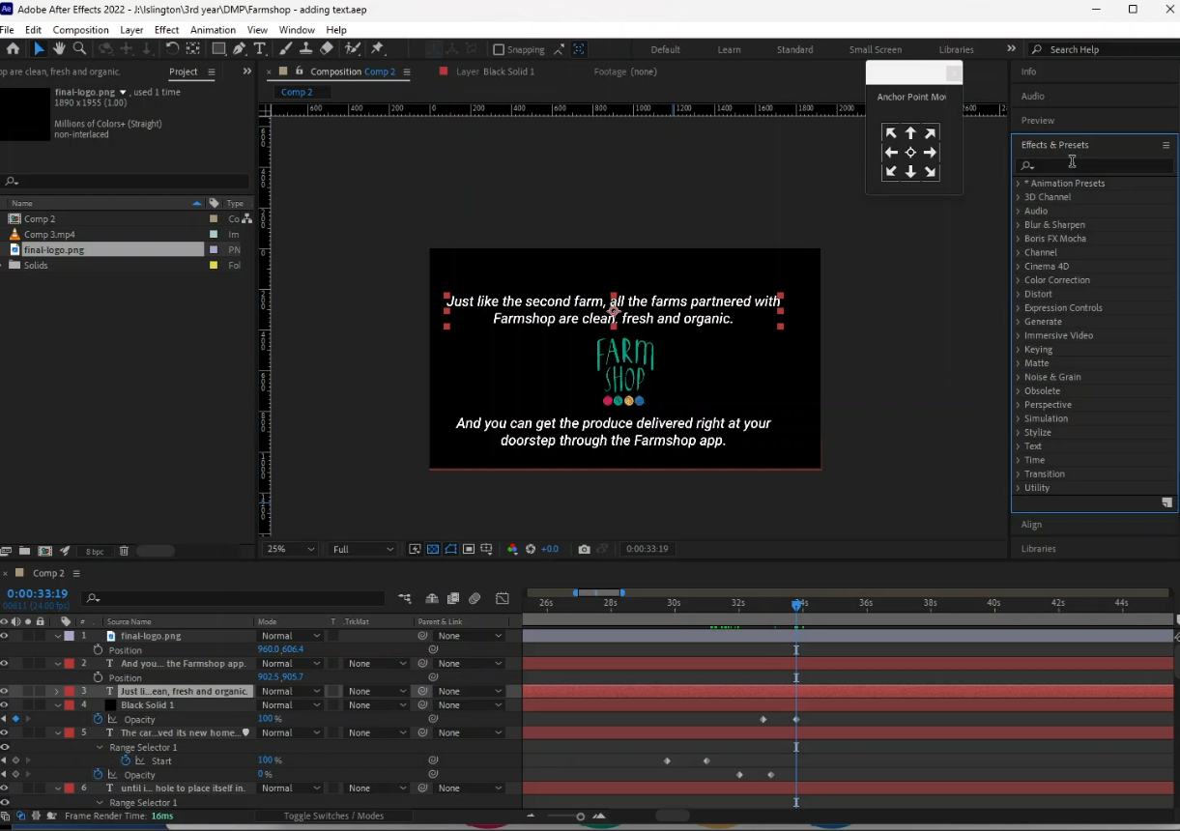
Project Development Process

Slide 15
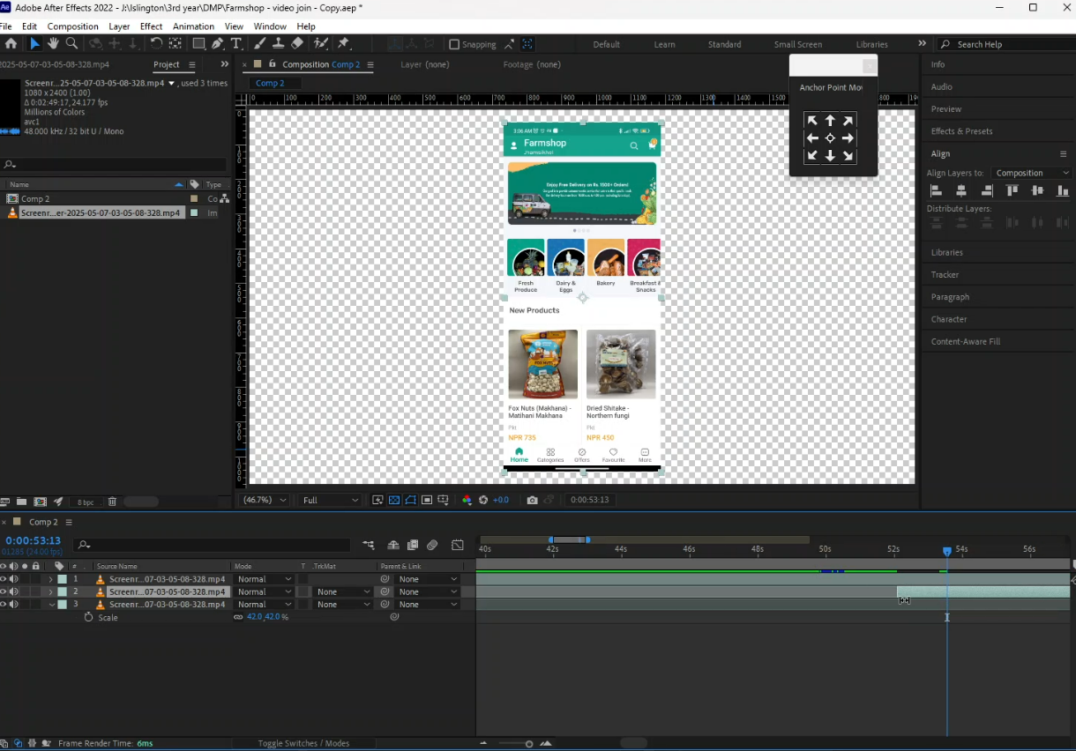
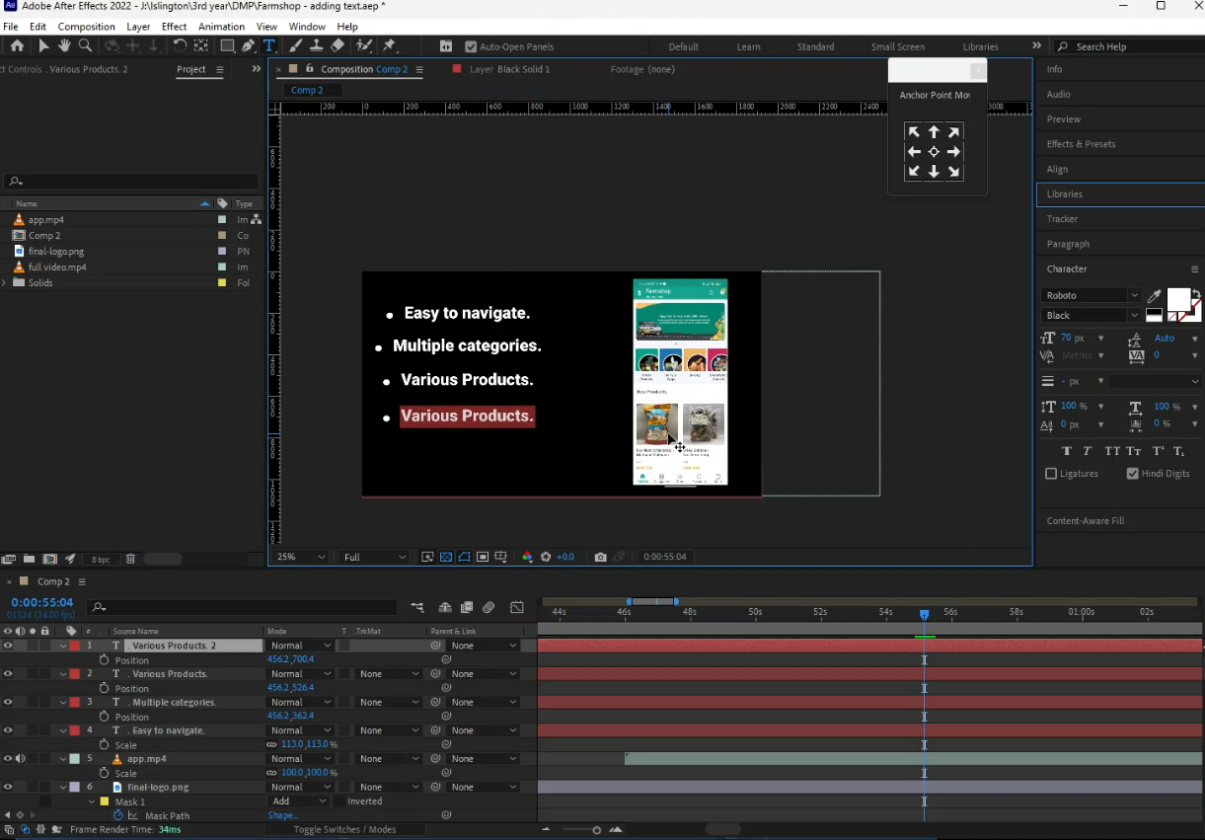
Project Development Process

Slide 16
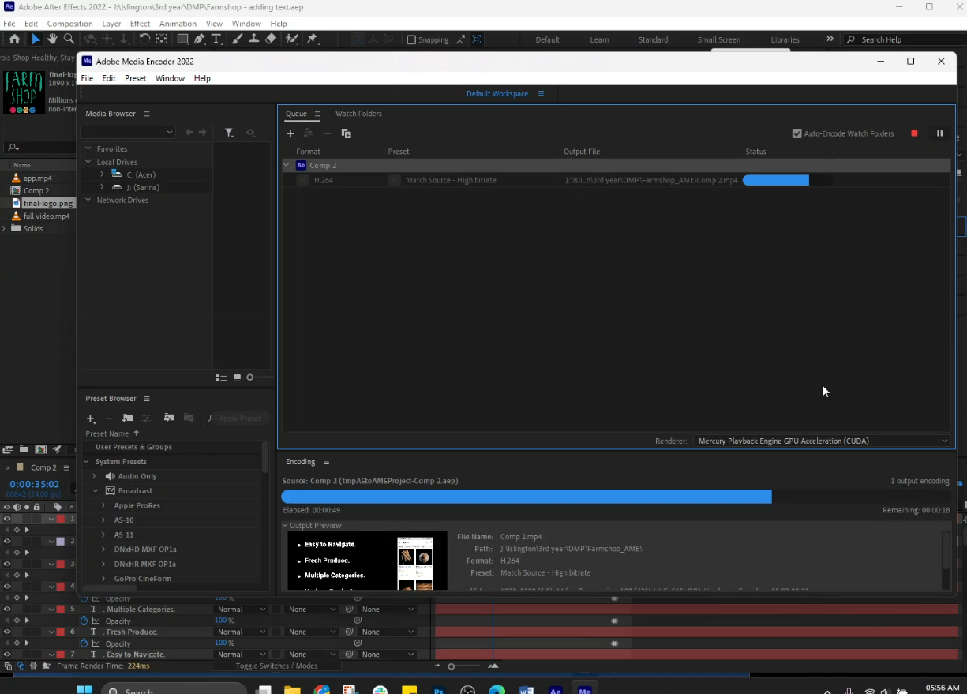
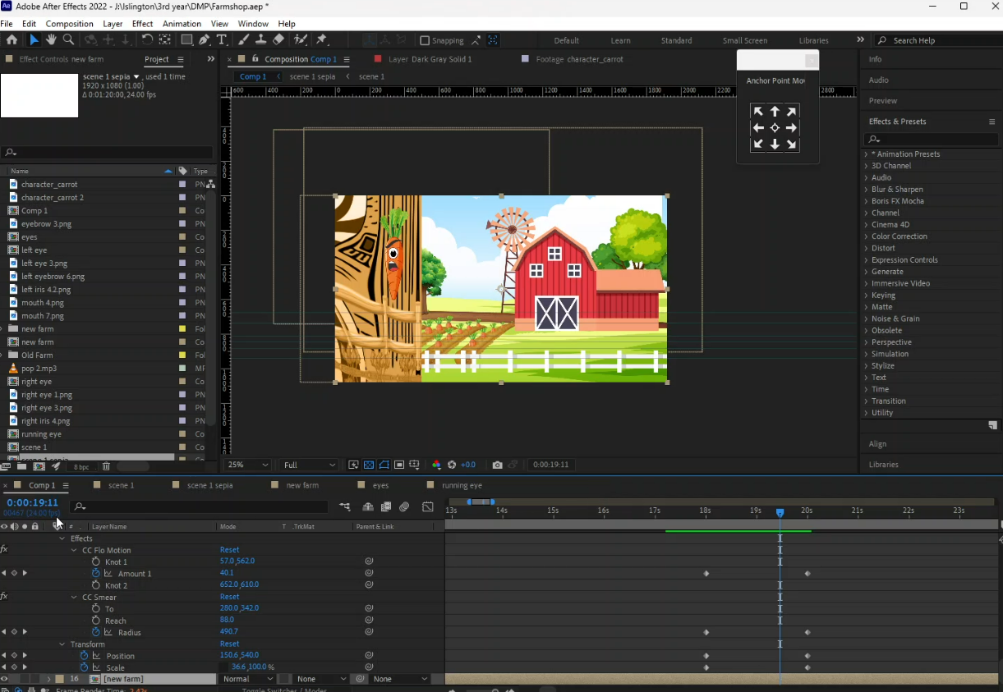
Project Development Process

Slide 17
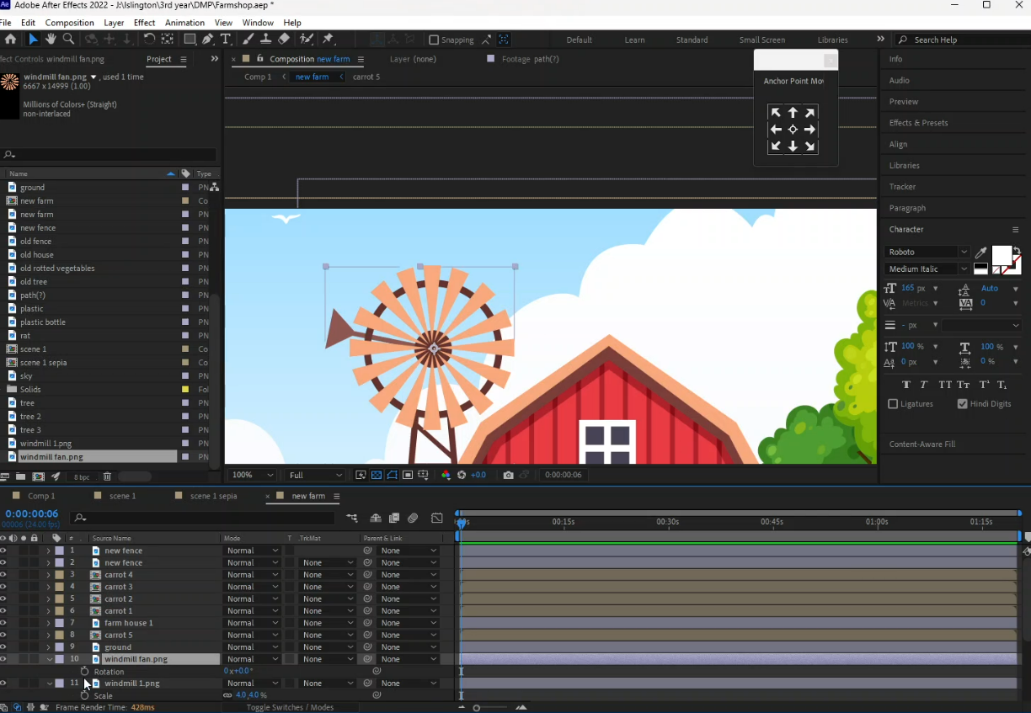
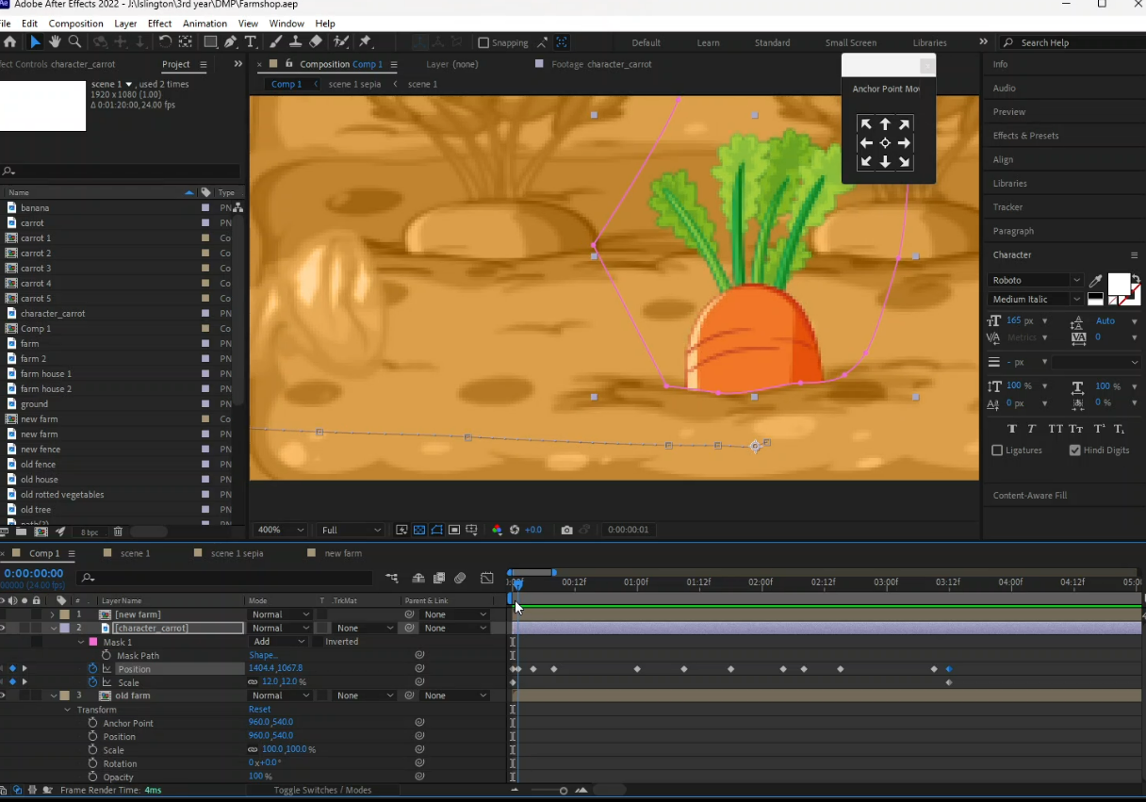
Project Development Process

Slide 18
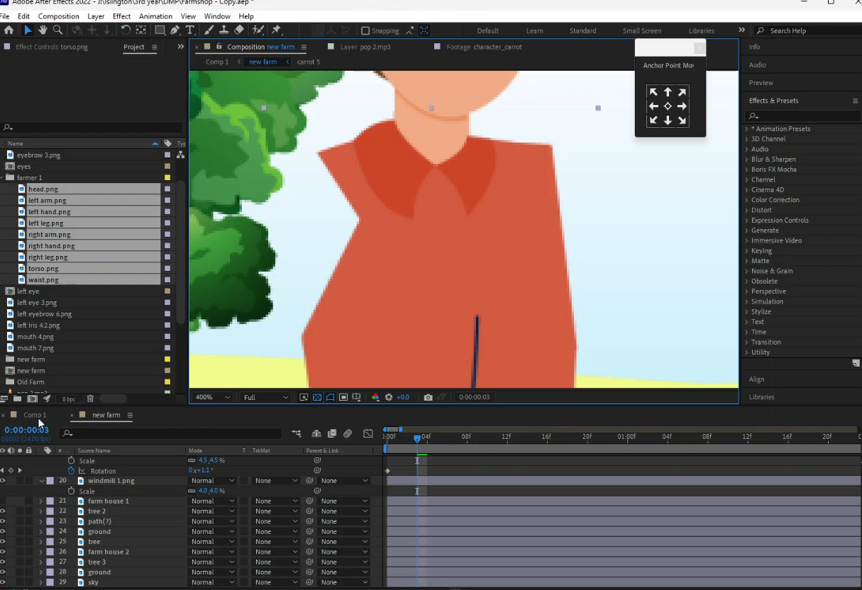
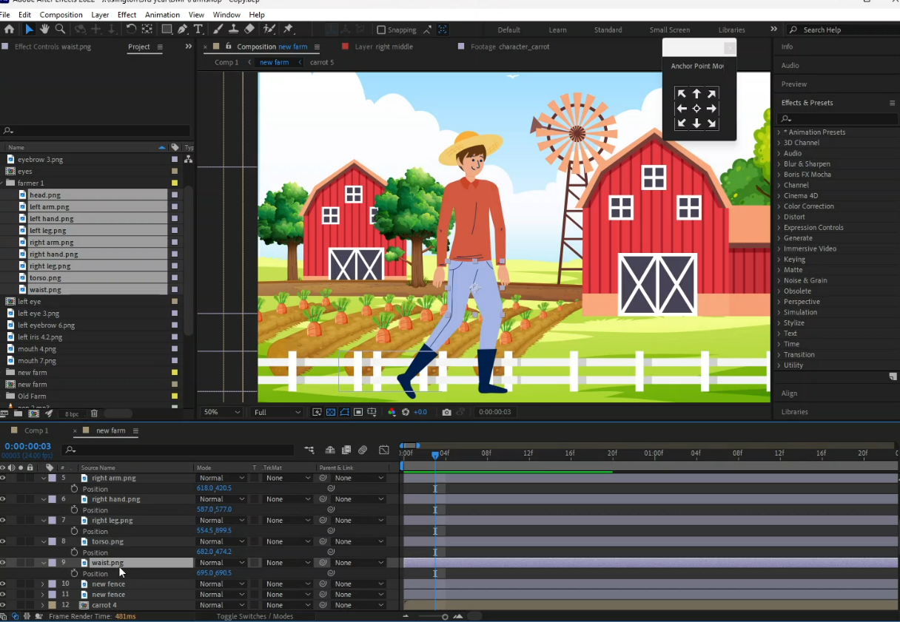
Project Development Process

Slide 19
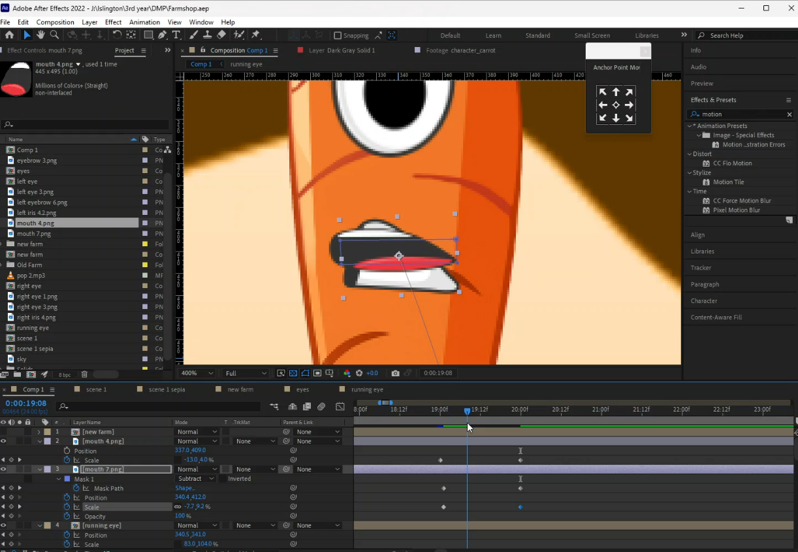
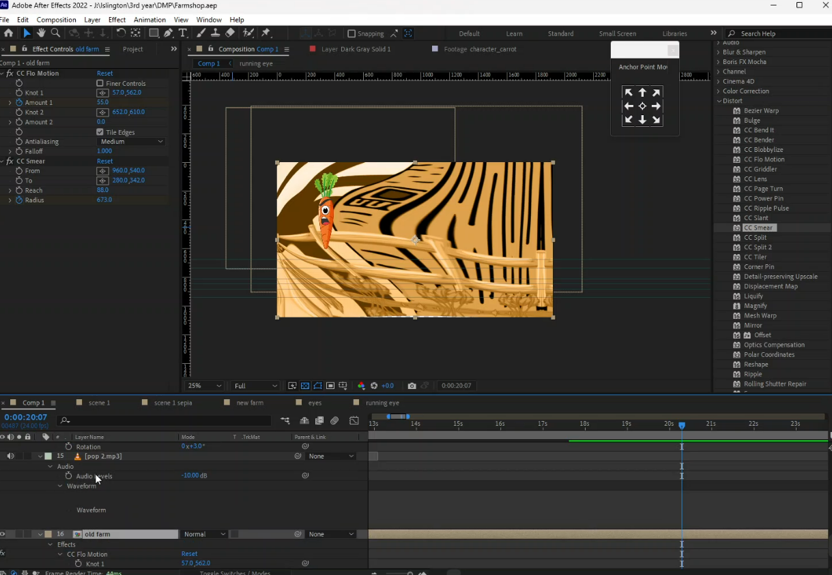
Project Development Process

Slide 20

Project Demonstration

